Slide 1

Module 2- Big Data Infrastructure
Hadoop Ecosystem- OOzie

Slide 2

Hadoop Ecosystem
Oozie- What is Possible?
Data Integration Example
3 jobs
2 scoop jobs to pull data from database
1 hive/map reduce job to join and process the data
All the jobs are independent
To complete this data integration process what is essential
“ A workflow based tool”
1st Database
3rd Database
2nd Database
Notes:
Take a data integration example. You might have to get a data set from one database and other data set from other database, then you want to join, process the data and reload it into a cache or 3rd database. It involves 2 sqoop jobs to pull data from database, a hive/map reduce job to join and process the data, then push into cache/database. All these jobs are dependent on each other, eg: we are supposed to process the data only after data is pulled from source databases. Hence we need to create a workflow to execute complete data integration process. OOZIE can facilitate that. It is map reduce based workflow tool. Workflow it self will be executed as one or more map reduce jobs.

Slide 3

Hadoop Ecosystem
Oozie-Motivation
How do we build it?
How it should update?

Slide 4
BIG DATA
Hadoop Ecosystem
We want to use the sales to build a recommendation system
Similar to Amazon
Recommendations are generally pre-computed
Online computation, too slow
5. Store in production database
4. Pre-compute recommendations
Production DB
1. Copy logs from production system
Logs
2. Dump database
Sanity Check
Recommendation
Production
Dataset
DB
3. Apply Big Data algorithms

Slide 5

Hadoop Ecosystem
What is Oozie?
Oozie is a workflow director system designed to run and manage multiple related Apache Hadoop jobs.
The sequence of steps is called a Workflow
Workflows are common in data centers
Users would like to
Specify the steps
Specify when the steps are to be run
Maybe periodically
Run the Workflow
What to do in case of error
Hadoop Ecosystem
HIVE Processing
HBase
Scoop
Flume

Slide 6
Hadoop Ecosystem
How is it different from YARN?
Sequence
Workflow
Run the Flow
Monitor the Flow
Monitor resources
YARN manages resources for individual Hadoop jobs and oozie provides a way to connect and control Hadoop jobs on the cluster
Job from oozie is submitted to YARN
Executes the Job
Allotting resources and managing resources not only for Oozie but for other as well

Slide 7
Hadoop Ecosystem
Types of Jobs
Generally the workflow is represented as DAG (Directed Acyclic Graph)
Workflow
Specified sequence of Hadoop Jobs
With outcome based decision points and control dependency.
Coordinator
Scheduled work flow job
Time and data dependent
Bundle
Batch a set of coordinated tasks

Slide 8
Hadoop Ecosystem
Oozie Workflow definitions
Type | Explanation
Control Flow Nodes | To denote the beginning and end of the workflow. Start End Optional Fail Nodes
Action Nodes | Processing takes place When action node finishes execution, next task in workflow will be executed
Fork/Join Nodes | Parallel execution of tasks in the workflow
Control Flow Nodes | Decision nodes are essentially switch statements

Slide 9
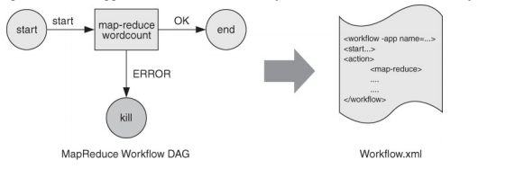
OOZIE DAG representation

Slide 10
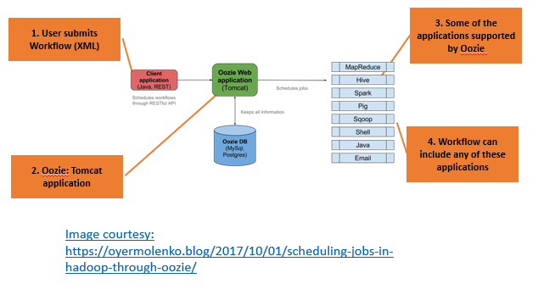
Hadoop Ecosystem
Oozie Architecture

Slide 11
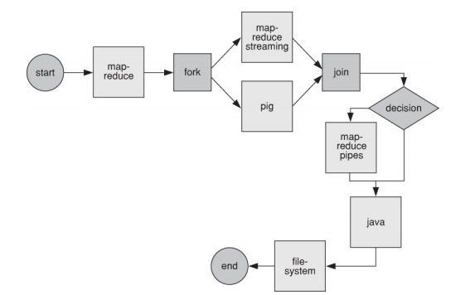
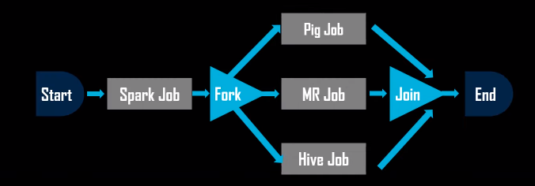
Hadoop Ecosystem
Oozie Workflow Types

Slide 12
OOZIE work through
Need to run a job using oozie and observe the workflow DAG

Slide 13
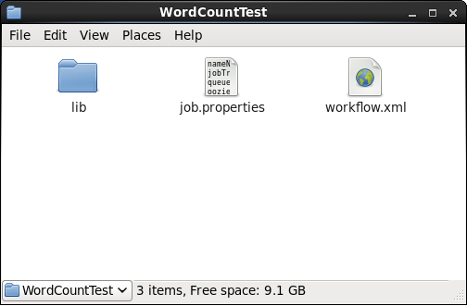
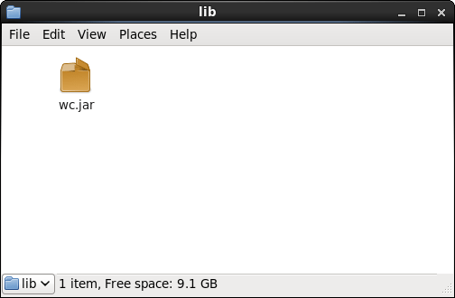
Tom White as part of appendix A they have given demo files for executing oozie the steps are as follows:

Slide 14
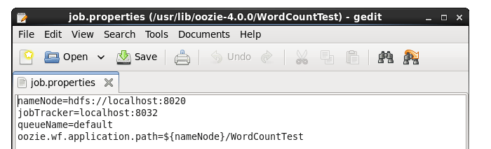
Step 2: Configuring job. Properties file
Here we will define the path of the Namenode and resource manager.
NameNode path is required for resolving the workflow directory path & jobTracker path will help in submitting the job to YARN.

Slide 15
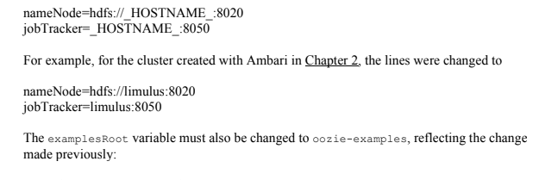
Job. properties file

Slide 16
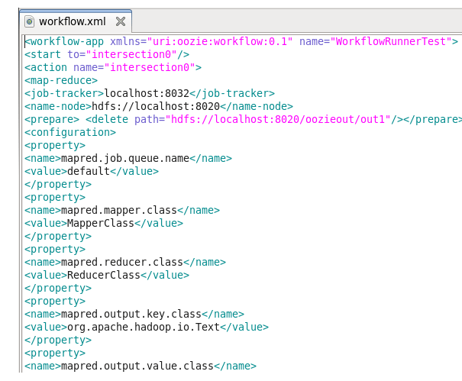
Step 3:Configuring XML file

Slide 17
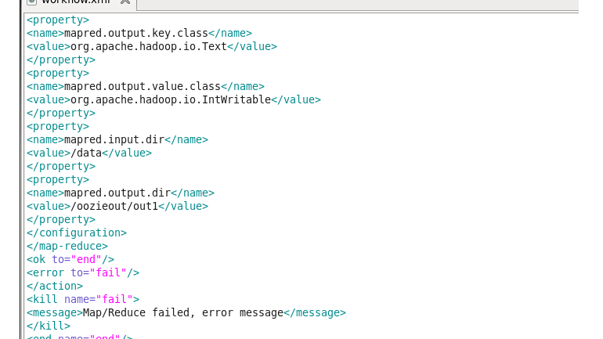
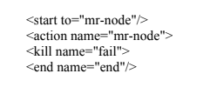

Slide 18

Step 4: Put the oozie job in Hadoop

Slide 19
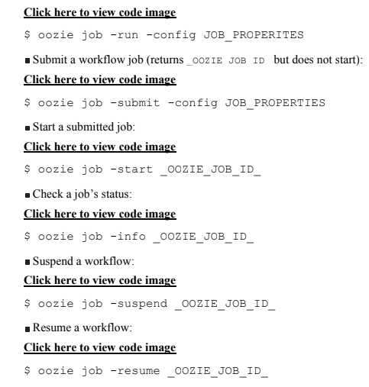
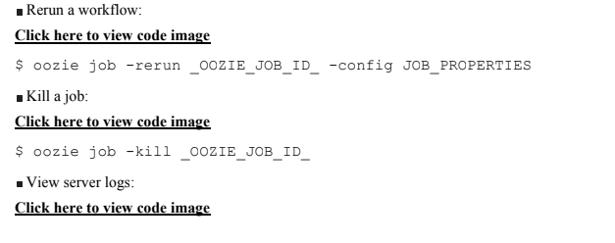

Slide 20
THANK YOU
“WORLD IS ONE BIG DATA PROBLEM”
“TORTURE THE DATA AND IT WILL CONFESS TO ANYTHING”

